Slide 1
System Setup
Install Oracle XE
SQL Developer Installation
Workstation Setup
Download Database Scripts
Setup Sample Data Models

Slide 2

Installing Oracle XE
Download OracleXE112_Win32.zip
System Requirements
Requirement | Explanation
OS | Microsoft Windows 2000 SP4 or greater
Disk Space | 1.75 GB of free space
Memory | 512 MB or RAM
Network | The TCP/IP network protocol must be configured and working
Internet Access | While not mandatory, it is recommended that you have internet access

Slide 3

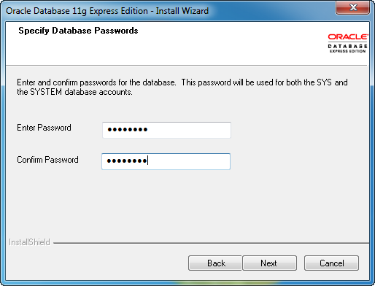
Installing Oracle XE
Pay close attention to this step.

Slide 4
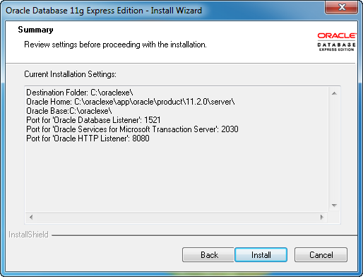
Installing Oracle XE
Pay close attention to the final step.

Slide 5
SQL Developer Installation
Installing SQL Developer is extremely simple.
It only requires that you copy the files to a folder on your system.
Once copied, find the sqldeveloper.exe file.

Slide 6
Final System Course Setup
Download Database Scripts
Create and Fill Database Tables

Slide 7

See it in Action

